Slide 1

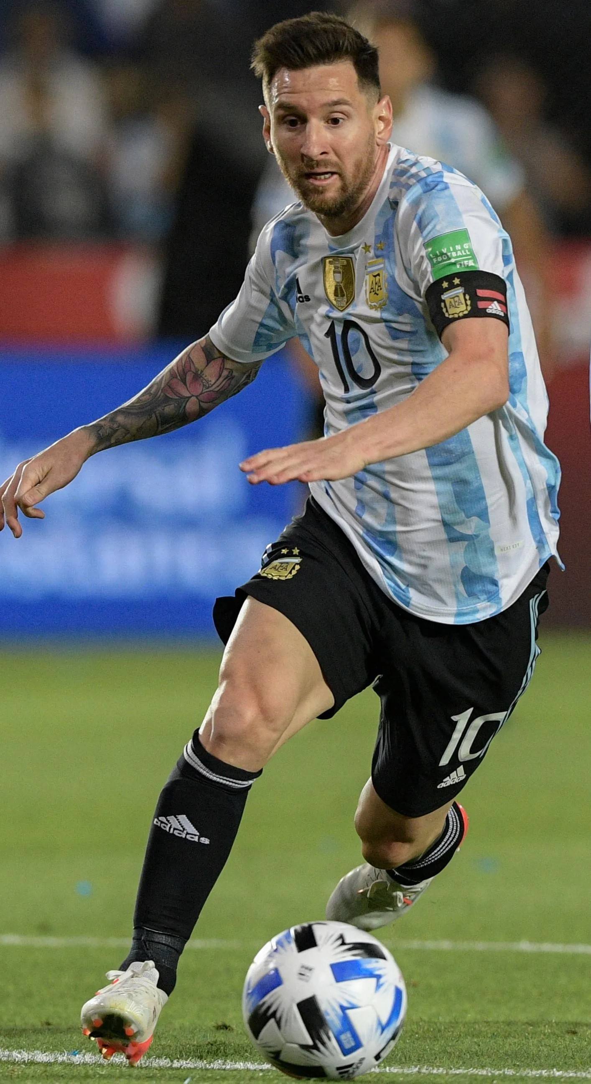

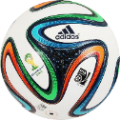


WORLD CUP ANALYSIS PROJECT
1930 - 2014
Presentation By
Saniya Shaikh

Slide 2

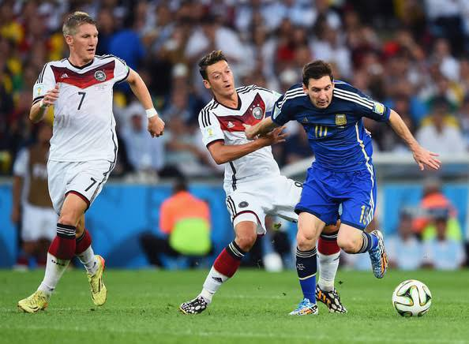

Project
Overview
Project Architecture
Introduction
About FIFA
Problem Statement
Objective
Dataset Description
Dashboards
KPI’s

Slide 3


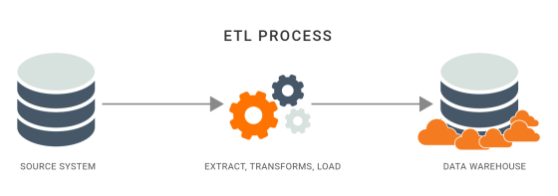

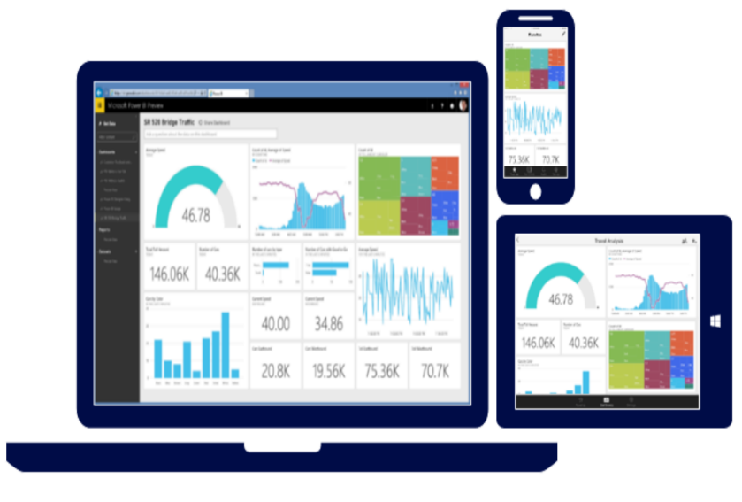



Project Architecture
Data Source
Power Bi
ETL Process
Data Modelling
Publishing Project
Presentation
Data Visualization

Slide 4

Introduction
The FIFA World Cup is an international football tournament that takes place every four years, bringing together the best national teams from around the world to compete for the title of world champion. It is organized by FIFA, the international governing body of football and is one of the most popular and widely watched sporting events into the world. The tournament is hosted by a different country each time, with the host nation providing the venues and infrastructure for the matches. The first FIFA World Cup was held in 1930 and since then it has grown in size and popularity, with millions of fans tuning in to watch the matches and support their favorite teams. The World Cup is not only a celebration of football, but also a cultural and social event that brings people from different countries and backgrounds together.

Slide 5
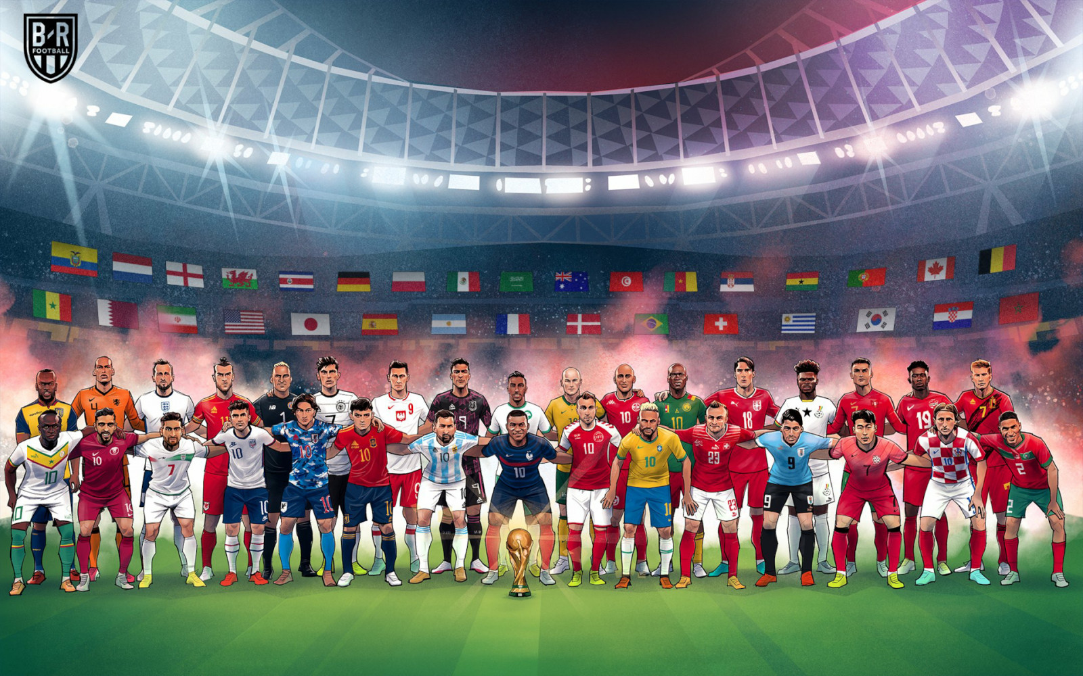


Slide 6

About FIFA
FIFA formed as early as May21, 1904 in Paris, but no national competition except for Olympics.
As the highest football authority, FIFA made its claim as the organizers of the competition.
1920’s – French football administrators, including Jules Rimet, are credited with bringing together the world’s strongest national teams to compete for a world championship of football
FIFA History
Decided that 1930 would be the first international competition for that what was called the “World Cup” and “La Coupe de Monde”.
To much debate as to who would host first World Cup.
FIFA felt it necessary for the first host nation to pay for travel expenses of all referees and national teams; a clearly expensive proposition, but many European and South American nations showed interest; the likes of football powerhouses; Italy, Spain, Holland, Hungary, Sweden and Uruguay.

Slide 7
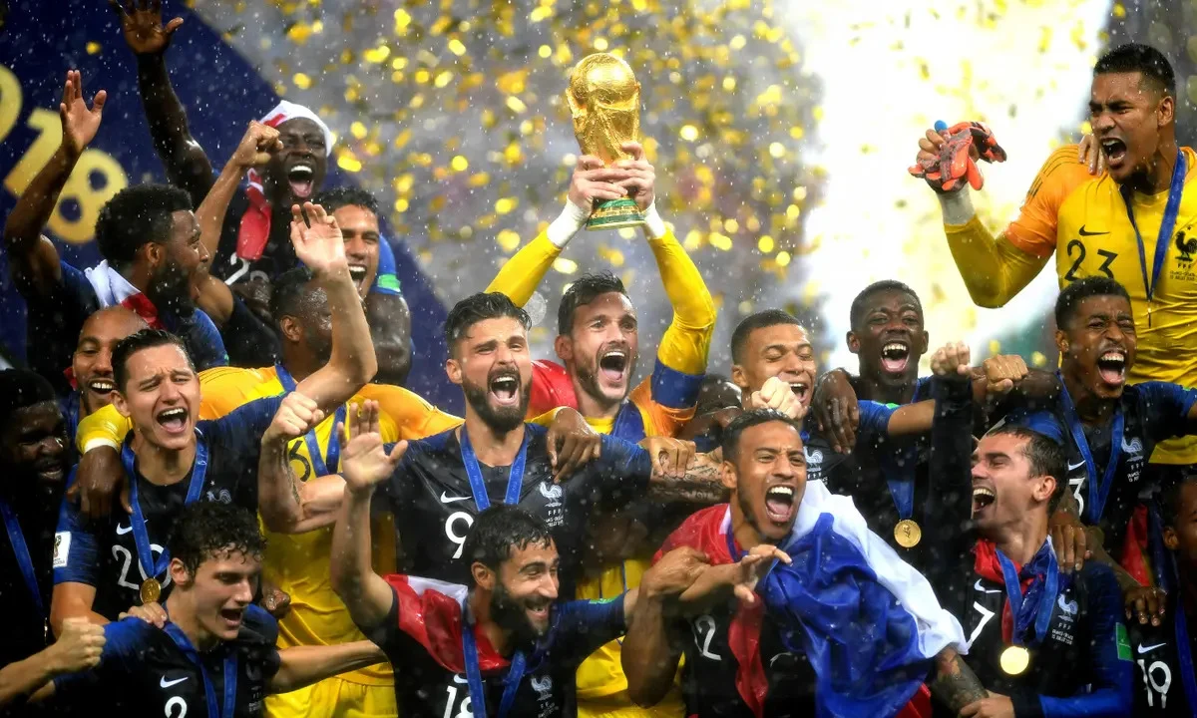
Problem Statement
With FIFA is in the blood of many people of the world. You are tasked to tell the story of unsung analysts who put great efforts to provide accurate data to answer every question of fans. The FIFA World Cup is a global football competition contested by the various football-playing nations of the world. It is contested every four years and is the most prestigious and important trophy in the sport of football. The World Cups dataset shows all information about all the World Cups in history, while the World Cup Matches dataset shows all the results from the matches contested as part of the cups. Find key metrics and factors that influence the World Cup win. Do your own research and come up with your findings.

Slide 8
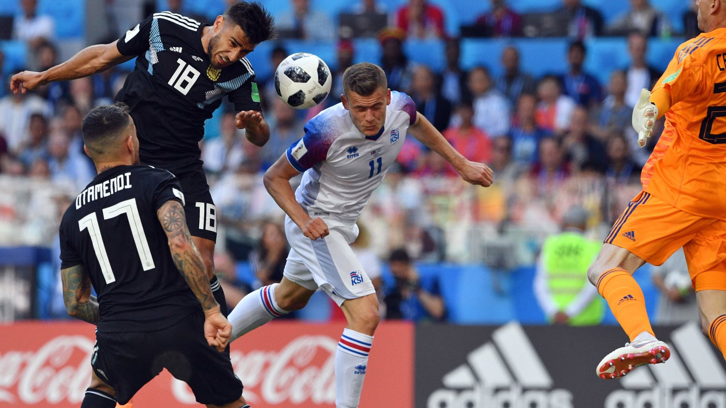
Objectives
Design dashboards with interactive elements allowing users to filter data by team, year, or player and to explore different aspects of data by historical trends, team comparison, players statistics, match analysis, tournament trends and visualizing key metrics
Historical Trends
Players Statistics
Tournament Trends
Analyze the performance of teams over different World Cup tournaments, track wins, goals scored, stadium which countries hosted, winning rates by home teams and away teams.
Visualize player performances by analyzing statistics like goals scored, assists and defensive metrics. Compare top players across different tournaments.
Identify trends and patterns across different World Cups, such as the impact of hosting countries or the influence of specific players or strategies.
Team Comparison
Match Analysis
Visualize Key Metrics
Compare teams based on various metrics such as goals scored , attendance and win rates. Visualize head-to-head results and group stage performance.
Analyze individual match results, including key events like goals, by country, position, qualified teams. Visualize winners, runner-up, third, fourth.
Create interactive dashboards showing metrics like total goals scored ,home teams, away teams , qualified teams as per year

Slide 9
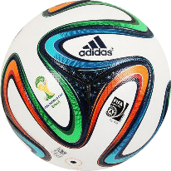




DATASET DESCRIPTIONS
The analysis is based on three comprehensive datasets
1930
2014
1. World Cups Dataset
Year: The year the World Cup took place.
Country: The host country for the tournament.
Winner: The team that won the World Cup.
Runners-Up: The team that finished in second place.
Third: The team that secured third place.
Fourth: The team that finished in fourth place.
Goals Scored: Total number of goals scored throughout the tournament.
Qualified Teams: Number of teams that qualified for the tournament.
Matches Played: Total number of matches played.
Attendance: Total number of spectators who attended the matches.
.
2. World Cup Matches Dataset
Datetime: Date and time of the match.
Stage: Stage of the tournament (e.g., Group Stage, Quarter-finals, Semi-finals, Final).
Stadium: Stadium where the match was held.
City: City hosting the match.
Home Team Name: Name of the home team.
Home Team Goals: Goals scored by the home team.
Away Team Goals: Goals scored by the away team.
Away Team Name: Name of the away team.
Win Conditions: Conditions under which the match was won (e.g., extra time, penalties).
Attendance: Number of spectators attending the match.
Half-time Home Goals: Goals scored by the home team by half-time.
Half-time Away Goals: Goals scored by the away team by half-time.
Referee: Name of the referee officiating the match.
Assistant 1 & Assistant 2: Names of the assistant referees.
Round ID: Identifier for the round in which the match was played.
Match ID: Unique identifier for the match.
Home Team Initials: Initials of the home team.
Away Team Initials: Initials of the away team.
3. World Cup Players Dataset
Round ID: Identifier for the round in which the player participated.
Match ID: Unique identifier for the match.
Team Initials: Initials of the team.
Coach Name: Name of the team's coach.
Line-up: Starting lineup of players for the team.
Shirt Number: Shirt number of each player.
Player Name: Name of each player.
Position: Position played by each player.
Event: Significant events involving players .

Slide 10
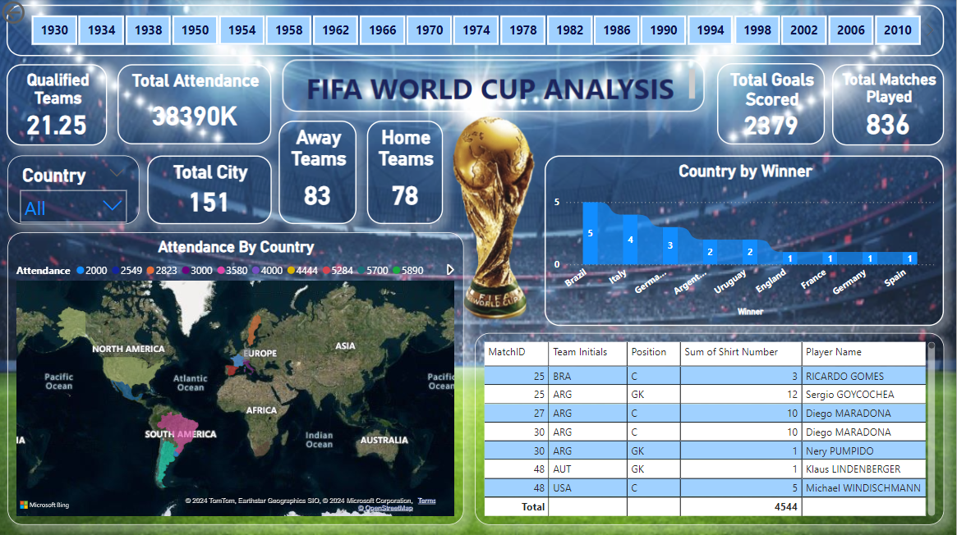
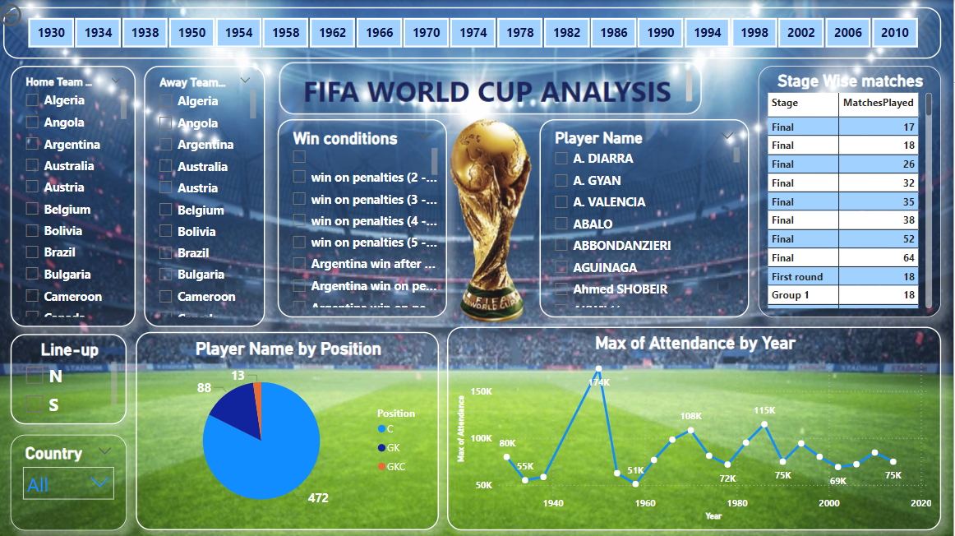
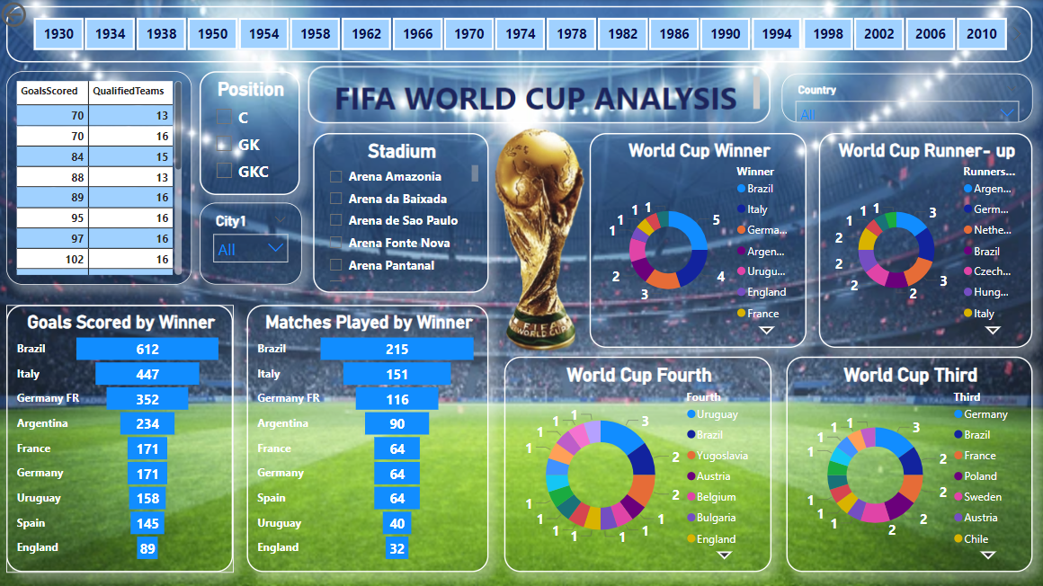
DASHBOARD
World Cup Stats
Team’s & Player’s
Win Analysis

Slide 11


01
Total Matches Played - 836.
Total Goals Scored – 2379
Total Attendance – 38390K
02
Away Teams – 83
Home Teams - 78
Top 3 World Cup Winners – Brazil, Italy, Germany FR
Top 3 Goals Scored
Brazil – 612
Italy – 447
Germany FR - 352
03
KPI’s
04
Top 3 World Cup Runner-Up – Argentina, Germany FR, Netherlands
Top 3 World Cup Third – Germany, Brazil, France
Top 3 World Cup Fourth – Uruguay, Brazil, Yugoslavia
05
Maximum Players are of C Position as compared to GK and GKC Positions
Year 1950 recorded the highest number of attendance

Slide 12
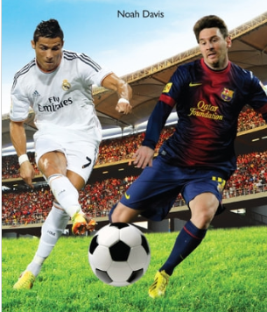


THANK YOU!

